Slide 1
AUTONOMOUS VEHICLE

Slide 2
CONTENT
INTRODUCTION
METHODOLOGY
REQUIRED COMPONENTS
ADVANTAGES
FUTURE SCOPE

Slide 3
INTRODUCTION
Driverless vehicle capable of sensing its environment and moving safely with almost zero human effort.
Environment friendly innovation. Use of renewable electricity instead of traditional non-renewable fossil fuel.
Have you ever thought about being in traffic back home and reset in your car by taking your hands off the steering wheel? Or read a book, watch video while the car is in the chaos of traffic jams?
I have many tech passion, but autonomous vehicles’ development is undoubtedly one of the most intriguing for me among the latest transportation industry trends.
Similarly, it is interesting to know in-depth about how the current self-driving technology works.

Slide 4
METHODOLOGY
Autonomous cars rely on sensors, actuators, complex algorithms, machine learning systems, and powerful processors to execute software.
Autonomous cars create and maintain a map of their surroundings based on a variety of sensors situated in different parts of the vehicle. Radar sensors monitor the position of nearby vehicles. Video cameras detect traffic lights, read road signs, track other vehicles, and look for pedestrians. Ultrasonic sensors in the wheels detect curbs and other vehicles when parking.
Sophisticated software then processes all this sensory input, plots a path, and sends instructions to the car’s actuators, which control acceleration, braking, and steering. Hard-coded rules, obstacle avoidance algorithms, predictive modeling, and object recognition help the software follow traffic rules and navigate obstacles.

Slide 5
REQUIRED COMPONENTS
Motor & Wheel
L 238 Dual Motor Driver
Male to Female Wire
Arduino uno
Bread Board
Ultra Sonic Sensor

Slide 6
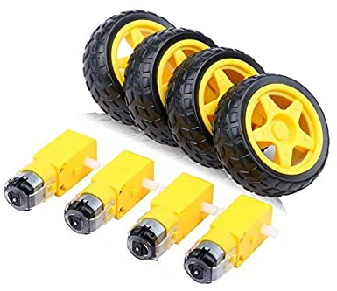
MOTOR & WHEEL
Four wheels
Four motors
Are use to assemble the autonomous car

Slide 7
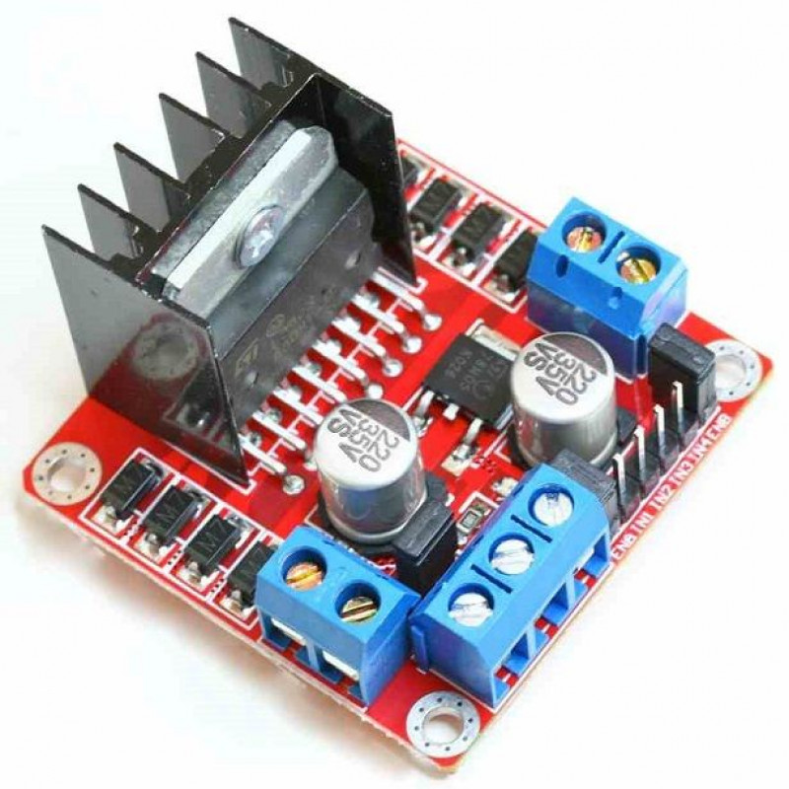
L 238 Dual Motor driver
This L 298 Dual Motor Driver Module is a high power motor driver module for driving DC and Stepper Motors. This module consists of an L 298 Dual Motor Driver IC and a 78M05 5V regulator. L298N Module can control up to 4 DC motors, or 2 DC motors with the directional and speed control.
The L 298 Dual Motor Driver module consists of an L 298 Dual Motor Driver IC, 78M05 Voltage Regulator, resistors, capacitors, power LED, 5V jumper in an integrated circuit.

Slide 8
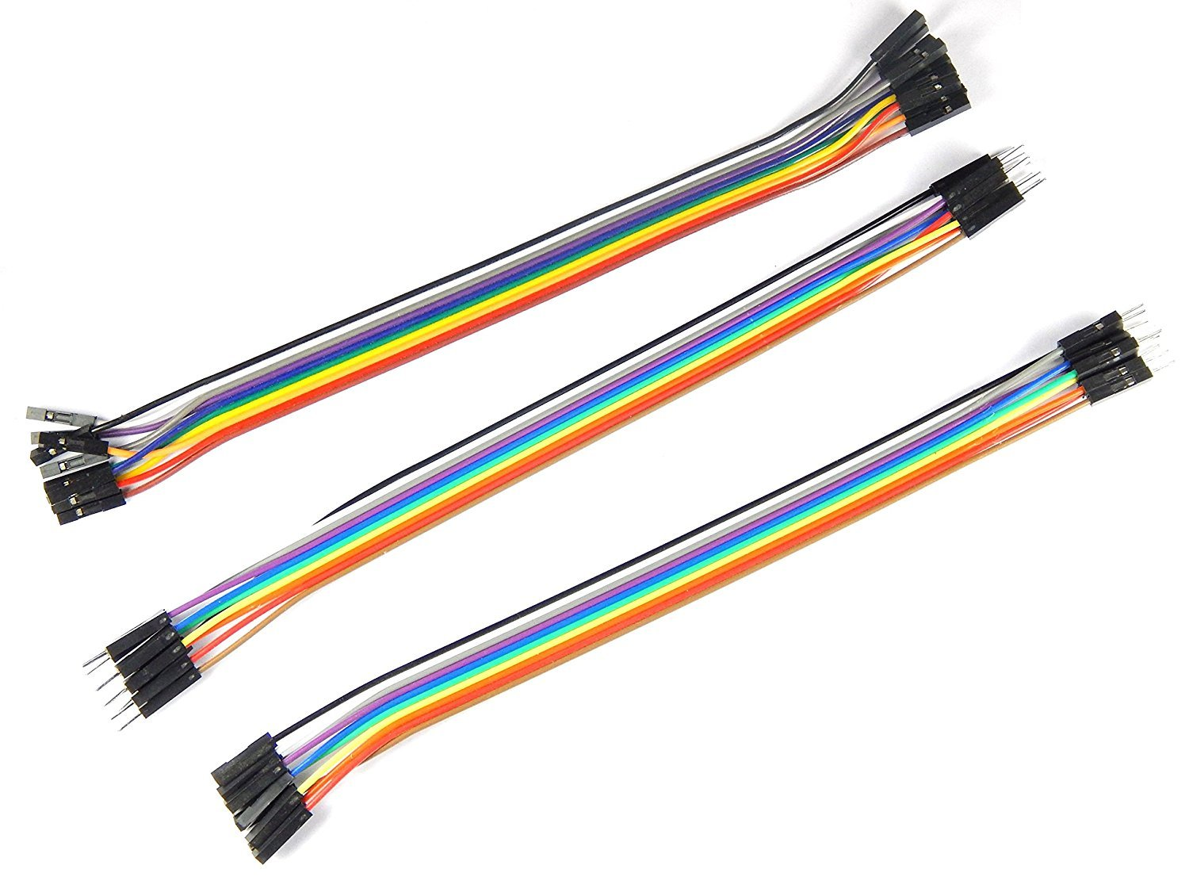
MALE TO FEMALE WIRE
For electronics components, gender is used to distinguish “mating connectors”. Mating interconnects match together in size, configuration and number of pins. In case you didn’t know a “male” connector usually has a pin or pins “sticking out” and the “female” connector is designed to receive those pins.

Slide 9
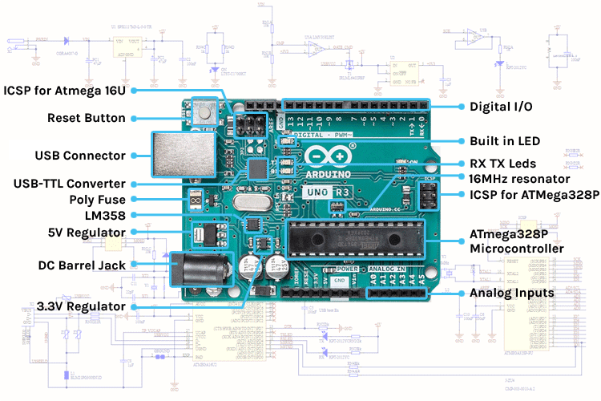
Arduino uno
The Arduino Uno board can be built with the power pins, along pins, ATmegs328, ICSP header, reset button, power LED, digital pins, test led 13, TX/RX pins, USB interface, an external power supply.
The 14 digital pins on the Arduino uno can be used as input & output with the help of the functions like pinMode(), digitalWrite(), & digitalRead().

Slide 10
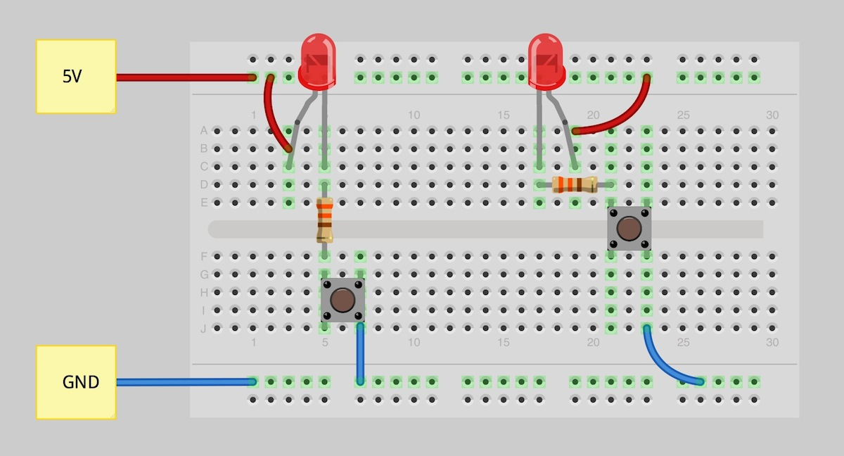
BREADBOARD
A breadboard is a solderless device for temporary prototype with electronics and test circuit designs. Most electronic components in interconnected by inserting their leads or terminals into the holes and then making connections through wires where appropriate.
The breadboard has strips of metal underneath the board and connect the holes on the tops of the board. The metal strips are laid out as shown below. Note that the top and bottom rows of holes are connected horizontally and split in the middle while the remaining holes are connected vertically.

Slide 11
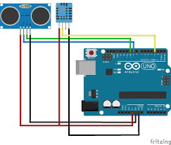
ULTRASONIC SENSOR
A breadboard is a solderless device for temporary prototype with electronics and test circuit designs. Most electronic components in interconnected by inserting their leads or terminals into the holes and then making connections through wires where appropriate.
The breadboard has strips of metal underneath the board and connect the holes on the tops of the board. The metal strips are laid out as shown below. Note that the top and bottom rows of holes are connected horizontally and split in the middle while the remaining holes are connected vertically.

Slide 12
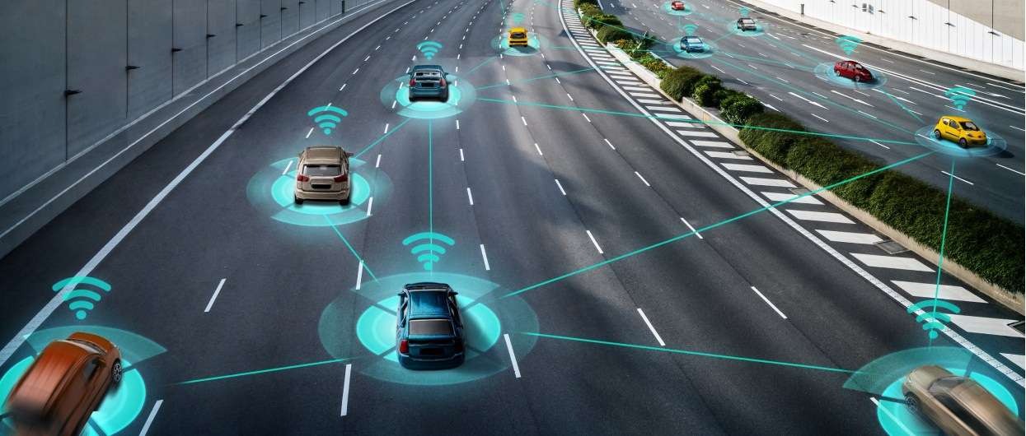

Slide 13
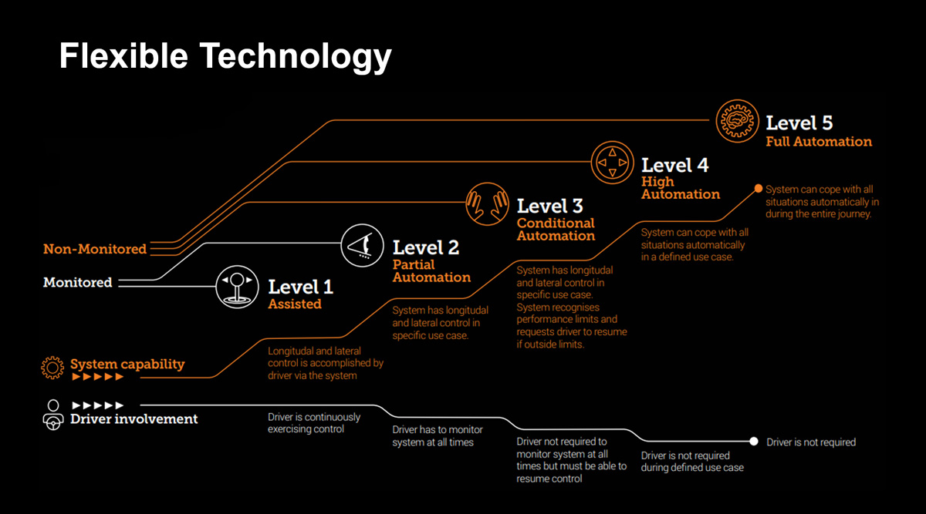

Slide 14
ADVANTAGES
It ensures quick and automated parking and easing retrieval of vehicle.
Low cost system, providing maximum automation.
Low maintenance levels are required by the system.
Users can access that occupancy data to determine the availability of slots.

Slide 15
FUTURE SCOPE
Autonomous Electric tram
Autonomous Underground Vehicle
Autonomous Vehicle are used in the agriculture sector for the various farming processes and used in mining operational tasks.
Different type of agriculture and mining autonomous vehicle are autonomous agriculture tractors, unmanned ground vehicles used for smart farms, mining vehicles such as mining trucks, mining automates machines etc.
It is autonomous vehicle utilized for indoor and outdoor applications. It is an unmanned vehicle used where human intervention is not easily possible in various conditions.

Slide 16
SUMMARY
In conclusion, upon addressing the mechanics of the driverless car as well as its benefits and potential issues, it is quite interesting to see how the world will actually become by the year 2040.
Sensors that are an integral part of the as autonomous vehicle will become more sophisticated and will potential have more functionality addition in near future.
It is fascinating to see the effects this creation will have on the states in which it is legalized as well as on the people that have chosen to experiment with it.
Cars will no longer be thought of as simply a transportation option, but rather a mobile entertainment center equipped with the wi-fi, televisions, and a entertainment dedicated onboard computer.
Japan has already begun to employ autonomous vehicles in the trucking industry.

Slide 17
THANK YOU

